Slide 1
Basic Functional Overview – O2C, P2P and R2R

Slide 2
What to Expect from the session
After the session there will be clear understanding of below mentioned topics
Standard Process Flows mapped with Oracle Modules
Key Tables and APIs

Slide 3
Topics
Order to Cash Lifecycle
Order to Cash Lifecycle- Setup Required
Order to Cash Lifecycle- Table Involved
Procure to Pay Lifecycle
Procure to Pay Lifecycle- Table Involved

Slide 4
Order to Cash Lifecycle
Order to Cash process steps can be listed as below:-
Enter the Sales Order
Book the Sales Order
Launch Pick Release
Ship Confirm
Create Invoice
Create the Receipts either manually or using Auto Lockbox
(In this article we will concentrate on Manual creation)
Transfer to General Ledger
Journal Import
Posting

Slide 5
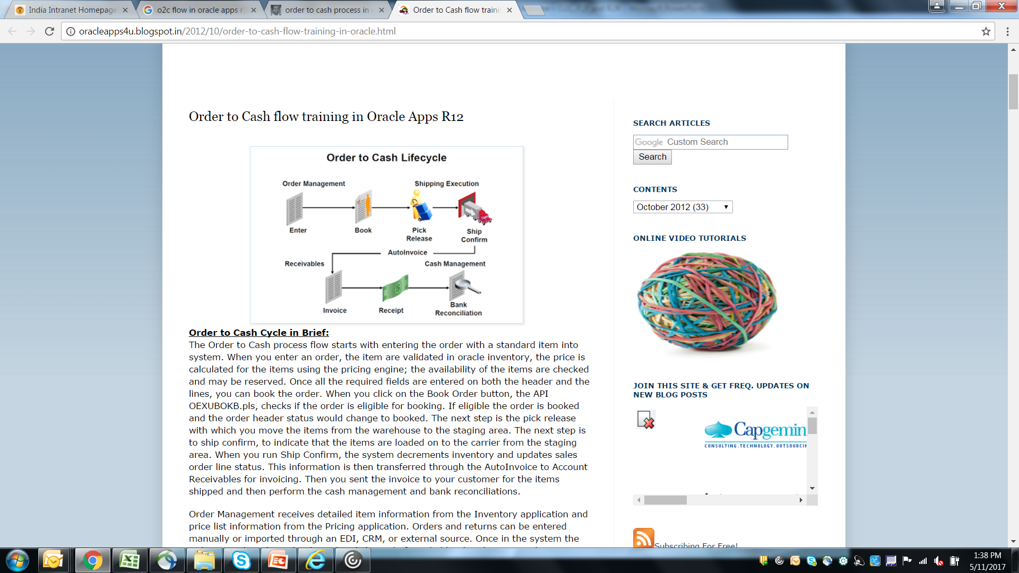
Order to Cash Lifecycle

Slide 6
Order to Cash Lifecycle – Setup Required
Setup steps for executing the Order to Cash flow with a standard item:
Prior to order entry, the items should be created/defined in inventory module using the master items screen and assigned to the shipping organization. Check the blog posts for the related setups.
Add the item to the price list.
Transaction Type must be defined.
Document sequence must be assigned to the document category.
Customers must be defined.
Salesperson must be defined.
Shipping Roles should be granted by the user.
Ensure that the items are available in your shipping sub inventory or perform miscellaneous transactions to augment the same.

Slide 7
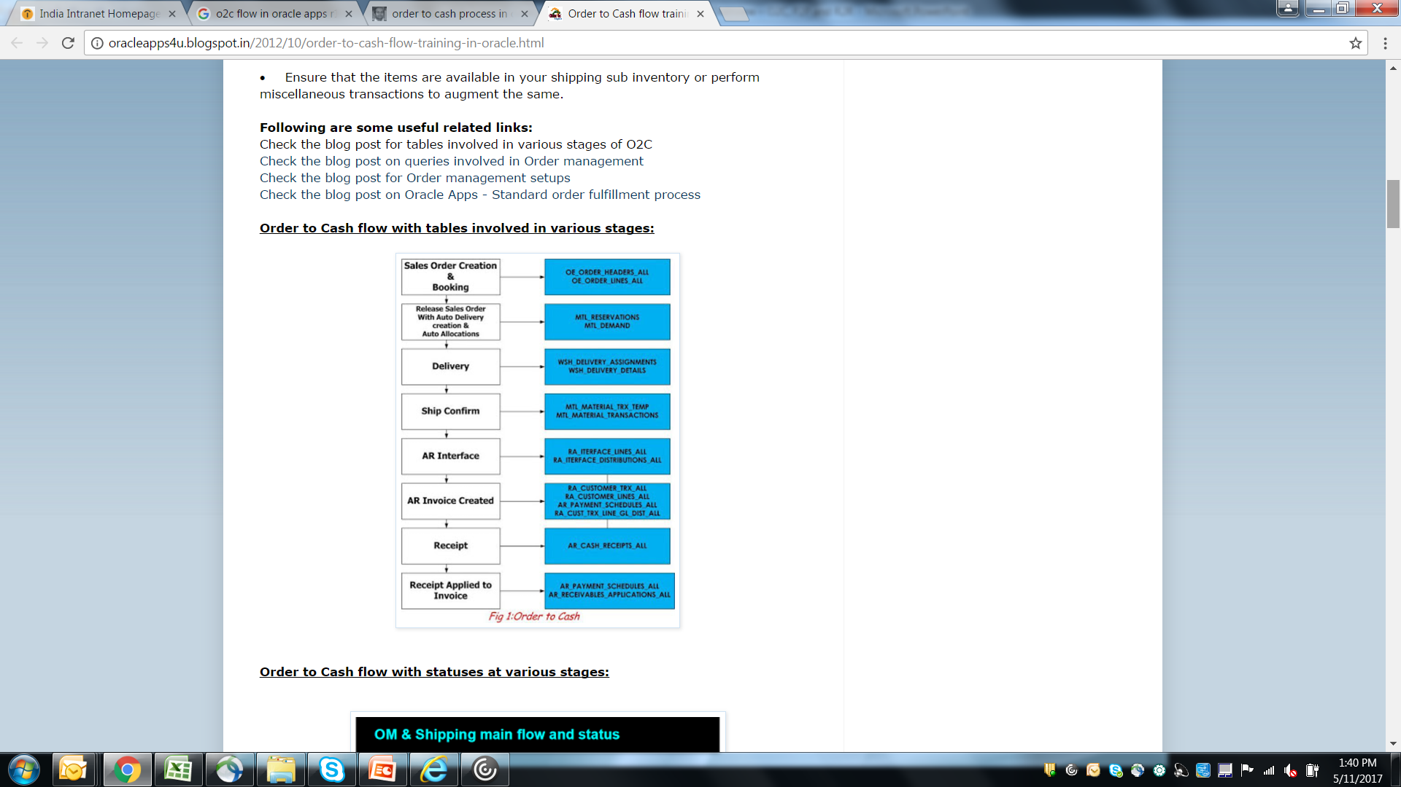
Order to Cash Lifecycle – Table Involved

Slide 8
Procure to Pay Lifecycle
Procure to Pay process steps can be listed as below
Create Requisition
Create Purchase Order
Create Inventory Receipt
Enter AP Invoice
Make Payment
Transfer to GL

Slide 9
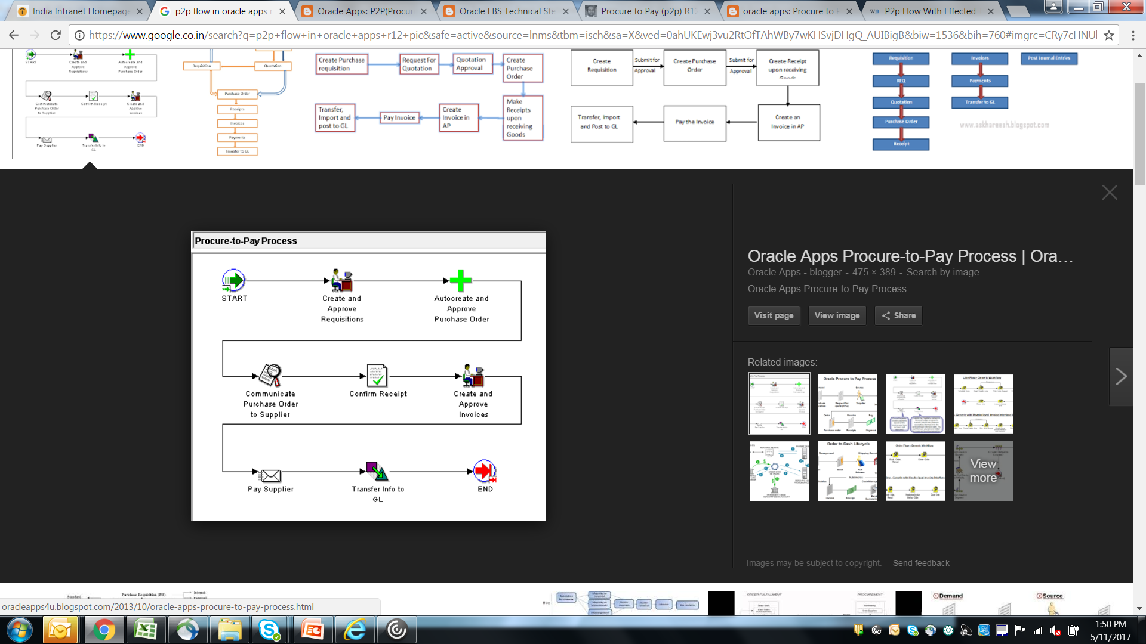
Procure to Pay Lifecycle

Slide 10
Procure to Pay Lifecycle – Table Involved
Create Requisition: PO_REQUISITION_HEADERS_ALL PO_REQUISITION_LINES_ALL PO_REQ_DISTRIBUTIONS_ALL
Create Purchase Order: PO_HEADERS_ALLPO_LINES_ALL PO_LINE_LOCATIONS_ALL PO_DISTRIBUTIONS_ALL
Create PO Receipt: RCV_SHIPMENT_HEADERS RCV_SHIPMENT_LINES (Lines Table has PO_HEADER_ID)

Slide 11
Procure to Pay Lifecycle – Table Involved
Create Invoice in Payables: AP_INVOICES_ALL AP_INVOICE_LINES_ALLAP_INVOICE_DISTRIBUTIONS_ALL Accounting Entries Tables: AP_ACCOUNTING_EVENTS_ALL AP_AE_HEADERS_ALL AP_AE_LINES_ALL
Making Invoice Payment: IBY_PAYMENTS_ALL or AP_INVOICE_PAYMENTS_ALL IBY_EXTERNAL_BANK_ACCOUNTS or AP_BANK_ACCOUNTS_ALL

Slide 12
Procure to Pay Lifecycle – Table Involved
1) Create Requisition: PO_REQUISITION_HEADERS_ALL PO_REQUISITION_LINES_ALL PO_REQ_DISTRIBUTIONS_ALL 2) Create Purchase Order: PO_HEADERS_ALLPO_LINES_ALL PO_LINE_LOCATIONS_ALL PO_DISTRIBUTIONS_ALL 3) Create PO Receipt: Receipt Tables are: RCV_SHIPMENT_HEADERS RCV_SHIPMENT_LINES (Lines Table has PO_HEADER_ID)

Slide 13
Procure to Pay Lifecycle – Table Involved
4) Create Invoice in Payables: Invoice Tables: AP_INVOICES_ALL AP_INVOICE_LINES_ALLAP_INVOICE_DISTRIBUTIONS_ALL Accounting Entries Tables: AP_ACCOUNTING_EVENTS_ALL AP_AE_HEADERS_ALL AP_AE_LINES_ALL 5) Making Invoice Payment: Payment Tables: IBY_PAYMENTS_ALL or AP_INVOICE_PAYMENTS_ALL IBY_EXTERNAL_BANK_ACCOUNTS or AP_BANK_ACCOUNTS_ALL

Slide 14
ETRM
Oracle eTRM -- https://etrm.oracle.com/
Sign in by entering user name and password.
Use the Oracle account created for Oracle Support.
Its electronic technical reference manual provided by Oracle.
It contains FND model and Data Dictionary which helps understanding the technical architecture of Enterprise Resource Planning (ERP) Systems

Slide 15
Questions and Answers

